Slide 1
Churn Prediction and Retention Analysis -by Omkar

Slide 2
Introduction
Objective: Help businesses understand customer behavior, predict churn, and provide actionable retention strategies using data analytics and machine learning.
Key Tools Used:
SQL: For data exploration and cleaning.
Python (Random Forest): Model development for churn prediction.
Power BI: For visualizing trends and insights to drive decision-making.

Slide 3
Project Goal
Business Challenge: Retaining customers is crucial for B2B businesses where losing a single client can result in significant revenue loss.
Project Goal: To predict which clients are most likely to churn and provide insights that can be used to create effective retention strategies.
Value for the Client: Data-driven insights can reduce churn by identifying pain points early, leading to proactive interventions.

Slide 4
Dataset Overview
Source: Customer data with key features such as:
Customer Demographics: Age, Gender, Marital Status, and State.
Service Usage: Internet Type, Contract Type, and Payment Methods.
Financial Data: Monthly Charges, Total Charges, Refunds, and Revenue.
Customer Tenure: Time spent with the company and number of referrals.
Target: Customer Status - Predict whether a customer will churn or stay.
Target: Customer_Status (Binary: 0 for Stayed, 1 for Churned)
Preprocessing:
Dropped irrelevant columns: Customer_ID, Churn_Category, and Churn_Reason.
Applied label encoding to categorical variables: Gender, Married, State, Internet_Service, etc.​

Slide 5
Data Exploration (SQL)
Objective: Uncover initial trends in the data before developing the model.
Data Cleaning: Handling null values using SQL, identifying missing fields like Total Revenue, and filling or replacing null values to ensure data integrity.
Used SQL queries to:
Identify null values.
Create views for churn data visualization in Power BI.
Exploratory Insights:
Customer Segmentation: Breaking down customers by gender, state, and service contracts to identify trends.
Revenue Analysis: Segment customers by status (churned/stayed) and calculate total revenue per group. For example, churned customers contribute to 40% of lost revenue.
​

Slide 6
Model Development (Python – Random Forest)
Algorithm: Random Forest, chosen for its ability to handle complex data structures.
Steps:
Data Splitting: Split into 80% training and 20% testing.
Training the Model: Built the model using the training set to predict churn.
Evaluation: Used metrics like accuracy, precision, recall, and F1-score and Confusion Matrix for evaluating performance.
Model Insights:
The model achieved 84% accuracy, with precision for predicting churn at 0.78.
The most significant factors in predicting churn include tenure, contract type, and monthly charges.

Slide 7
Key Predictive Factors (Feature Importance)
Top 5 Influential Factors:
Tenure in Months: Longer tenured customers are less likely to churn.
Contract Type: Customers with yearly contracts churn significantly less compared to those on month-to-month plans.
Monthly Charges: Higher monthly charges correlated with increased churn likelihood.
Payment Method: Customers using mailed checks are more likely to churn compared to those using online payments.
Internet Type: Fiber Optic users are more prone to churn due to potential service issues.

Slide 8
Power BI Dashboard Highlights
Churn by Tenure:
Visual showing that customers with tenure <12 months have a churn rate of 27.5%.
Churn by Contract Type:
Annual contract customers have a churn rate of only 10%, while month-to-month customers churn at 41%.
Churn by Payment Method:
Mailed Check users have the highest churn rate at 37.82%, signaling an opportunity to promote more convenient payment methods.
Churn by Industry Segment :
Small businesses (25-50 employees) have a higher churn rate due to more price-sensitive needs, while larger enterprises (500+ employees) tend to stay longer due to established contracts
Churn by Internet Type:
Highest churn for Fiber Optic users (41.10%), indicating dissatisfaction with that service​.
Churn by Age Group:
The age group 20-35 has the highest churn rate at 31.55%

Slide 9
Business Impact and Recommendations
Key Findings:
Short-term customers and small businesses are at higher risk of churn.
High churn among users with mailed check payments suggests an opportunity to encourage online payments or automatic billing.
Fiber-optic customers show higher dissatisfaction, possibly due to service quality issues.
Actionable Recommendations:
Target High-Risk Customers: Implement a loyalty program for customers with less than 12 months of tenure, offering discounts on longer contracts.
Payment Method Incentives: Encourage customers using mailed checks to switch to electronic payments by offering incentives or discounts.
Improve Service Quality: Investigate potential issues with fiber-optic services to improve customer satisfaction and reduce churn.

Slide 10
Retention Strategies
Personalized Retention Campaigns:
Develop personalized offers for high-churn risk segments, focusing on price-sensitive industries and customers with month-to-month contracts.
Customer Success Programs:
Implement proactive customer success programs targeting small and medium-sized businesses (SMBs) with a dedicated customer success manager to address needs early.
Contract Flexibility:
Offer flexible contract options for larger enterprises with the ability to adjust services based on usage, ensuring a tailored experience.

Slide 11
Summary
Summary: By utilizing predictive modeling and analytics, we can not only identify customers likely to churn but also pinpoint the driving factors behind churn.
Next Steps: Implement the suggested retention strategies and continue refining the churn model with additional data to enhance predictions.
Call to Action: Use data-driven insights to create personalized customer retention strategies that drive long-term loyalty and business growth.

Slide 12
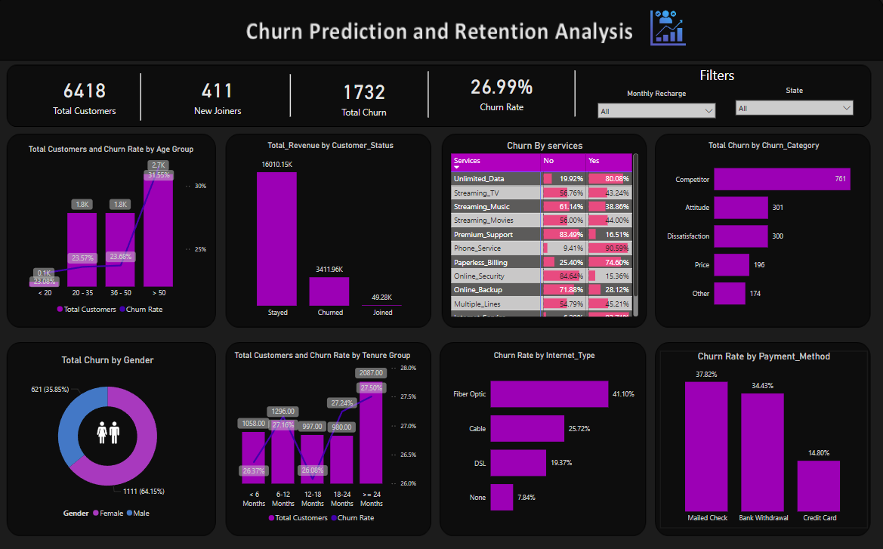
Power BI Dashboard - Churn Analysis

Slide 13
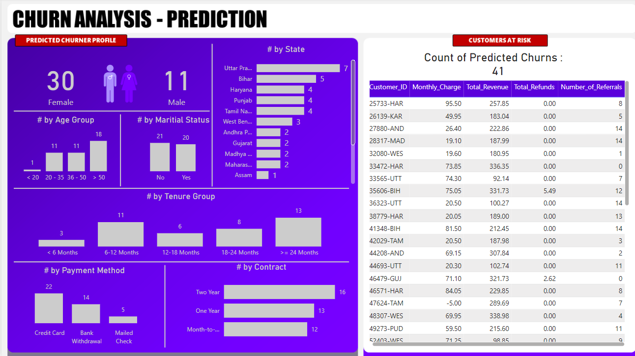
Churn Prediction

